Slide 1
SATELLITE LIFE EXPECTANCY
Joshlyn Jamerson
Notes:
Good afternoon, my name is Joshlyn Jamerson and today I’m going to tell you all about satellite life expectancy.

Slide 2
STAKEHOLDER INTEREST
Resource Allocation
Mission Planning
Operational Continuity
Cost Management
Situational Awareness in the Space Domain
Notes:
So why does knowing about satellite life expectancy benefit military stakeholders?
Knowing about what affects the life of a satellite allows for better mission planning, including scheduling replacements or adjustments to ensure continuous and reliable satellite coverage.
Understanding the factors that affect satellite lifetimes, such as orbit type, can help the military allocate resources effectively by choosing the most suitable orbits for different types of missions.
Satellites play a crucial role in maintaining situational awareness, command and control, and communication during various operations. Knowing which orbits provide longer lifetimes can contribute to more reliable and sustained operations.
Satellite development, launch, and maintenance are extremely costly. By understanding factors that influence satellite longevity, the military can make informed decisions about investment in satellite technology, design, and orbits to optimize the cost-effectiveness of their satellite programs.
Space situational awareness, which involves monitoring and tracking objects in space, helps to prevent collisions and protect satellites from potential threats. Knowledge of satellite lifetimes can aid in predicting end-of-life scenarios and potential debris creation.

Slide 3
AGENDA
Database Information
Hypothesis
Regression
Results
Notes:
Here’s an overview of the topics I’m going to cover.
I’ll start with giving information about the database, discuss my hypothesis, go over my regression model, and the results of my research.

Slide 4
COLUMNS OF INTEREST
Expected Lifetime (Years)
Launch Mass (Kilograms)
Inclination (Degrees)
Apogee (Kilometers)
Perigee (Kilometers)
Class of Orbit
Notes:
The columns I was interested in include:
Expected Lifetime, Launch Mass, Inclination, Perigee, Apogee, and Class of Orbit

Slide 5
Data wrangling
Inconsistencies with Expected Lifetime (Years)
Created Dummy Variables for Class of Orbit
Deleted Null values
Expected Lifetime (Years)
Launch Mass (Kilograms)
Notes:
This is how I had to clean up the data to make it usable.
The majority of the issues were in the expected lifetime column. Some of the data was in ranges while others were just a specific number. To tackle this issue, I replaced the range with the mean.
I also had to create dummy variables for class of orbit as it was one categorical column. Creating the dummy variables allowed me to make comparisons between how the different orbits behaved.
There were null values in both the expected lifetime column and in the launch mass column, so I deleted the null rows to avoid any complications with the data.

Slide 6
HYPOTHESIS
H₀ : Satellites in GEO will have a similar life expectancy compared to those in other orbits
H₁ : Satellites in GEO will have a longer life expectancy compared to those in other orbits
Notes:
My null hypothesis is that Satellites in GEO will have a similar life expectancy compared to those in other orbits
My Alternative hypothesis is that Satellites in GEO will have a longer life expectancy compared to those in other orbits

Slide 7
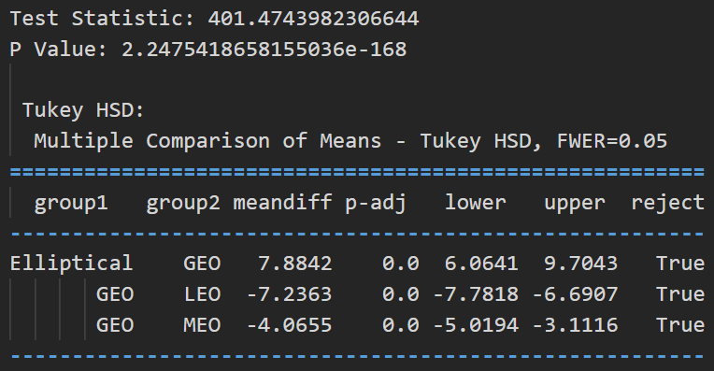
HYPOTHESIS TESTING
ANOVA TEST
Significance level = 0.05
Reject Null Hypothesis
Low P value
High Test Statistic
Tukey HSD
Notes:
I decided to use an ANOVA test for my hypothesis as it allowed me to determine whether the means of the life expectancy for each orbit were significantly different from each other.
This test compares the variability within each orbit to the variability between the orbits and calculates a test statistic and p-value to assess the significance of the differences.
In this test, I set my significance level to 0.05 which means that if the p-value is greater than 0.05 then we do not have enough evidence to reject the null hypothesis.
In this case, our P value is significantly smaller than 0.05 which means that we can reject the null hypothesis, proving that satellites in GEO have a longer life expectancy than those in other orbits.
I also used a Tukey HSD after completing the ANOVA test which shows the specific comparison between each group. It shows the mean difference in years

Slide 8
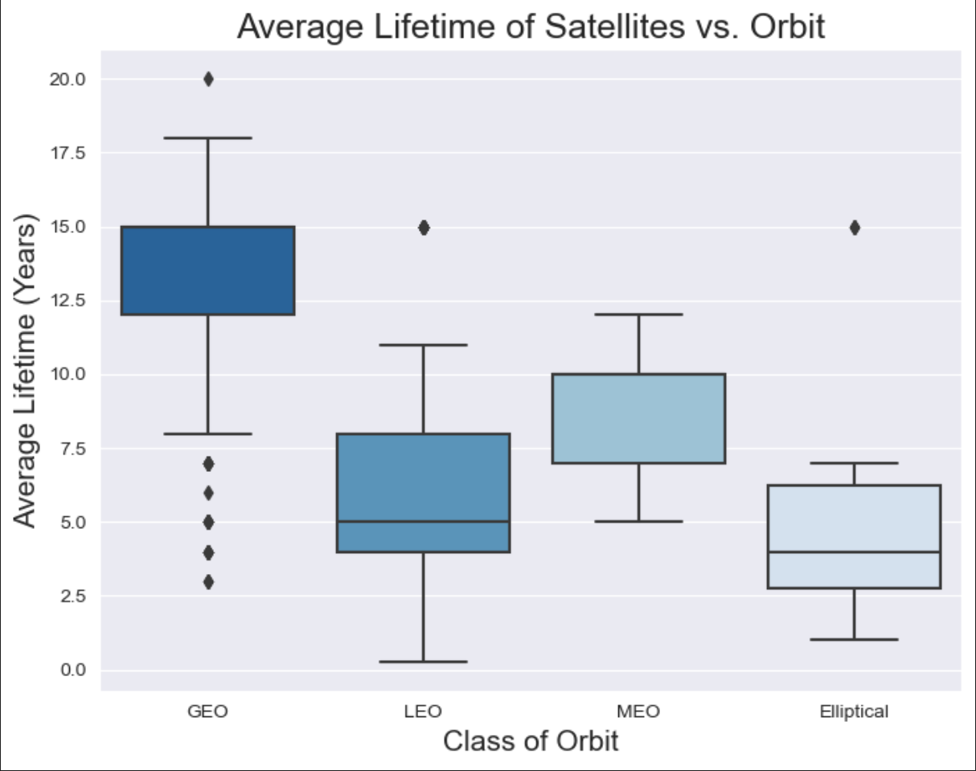
Notes:
Here is a visual representation that shows the average life-time of a satellite based on years.
As you can see GEO has the highest life expectancy whereas elliptical has the lowest life expectancy.

Slide 10
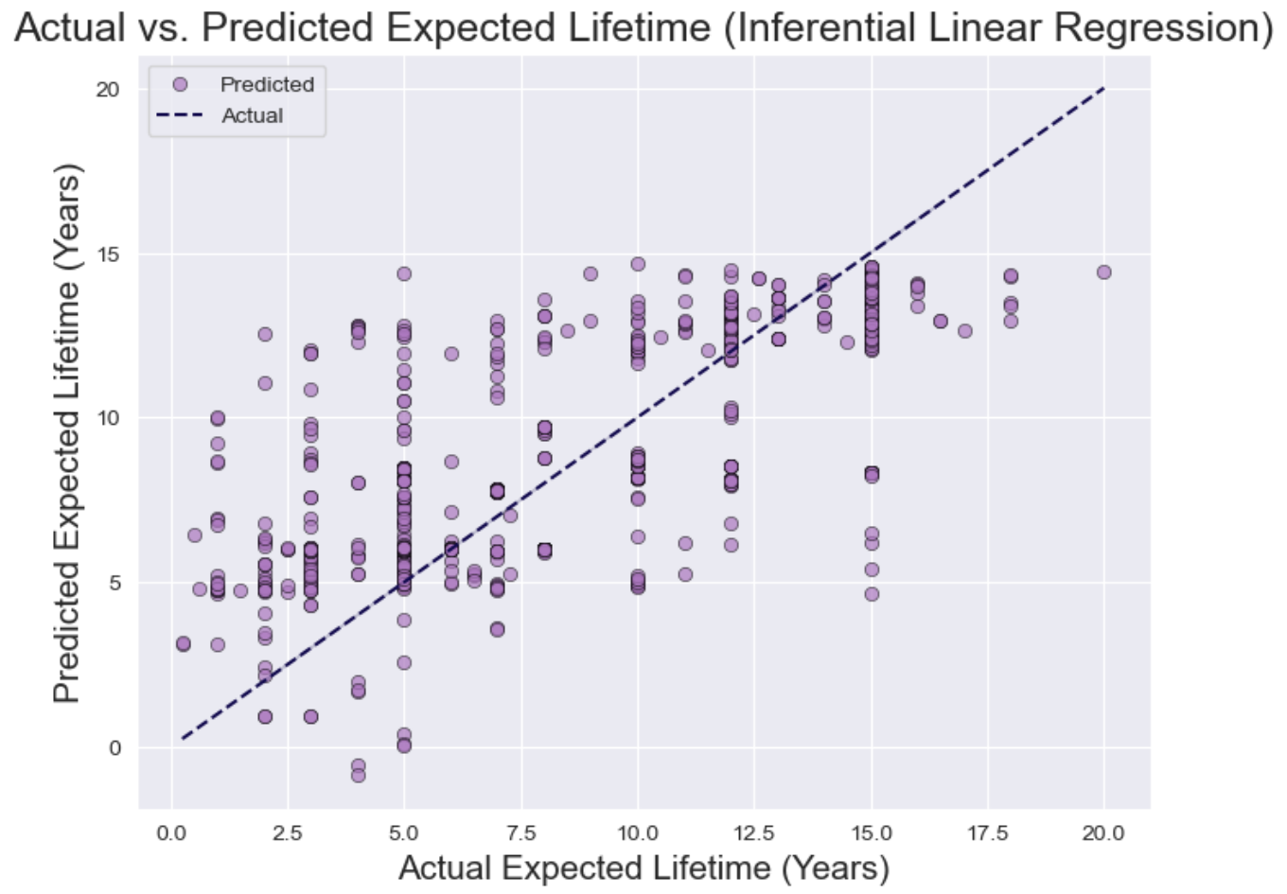

Slide 11
TYPES OF TOKENS
Payment
Utility
Security
NFT
Gaming
Used to complete transactions anywhere crypto is accepted
These tokens have a specific use within a blockchain
Tokens backed by securities
Authenticates ownership of specific assets
Used as in-game currency and traded with real world value

Slide 12





PORTFOLIO BUILDUP
Step 1
Step 2
Step 3
Step 4
Step 5
Choose a cryptocurrency exchange
Purchase preferred coins & create "wallet"
Research investment and trading options
Stake preferred coins in chosen company
Set exponential growth goals

Slide 13
HOW TO GET THERE
Strategize
Minimize risk
Utilize resources
Do your research and develop a plan with goals
Diversify your portfolio through coin ownership​
Follow the markets closely​
Be cautious of scams and "too good to be true" scenarios
Avoid "all-in" strategies
Apps and platforms help streamline user experience
Seek expert guidance from Krypto Logics team members​

Slide 14

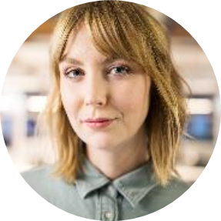
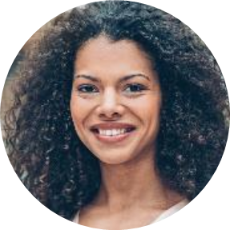

MEET OUR TEAM
Takuma Hayashi​
Mirjam Nilsson​
Flora Berggren​
Rajesh Santoshi​
President
Chief Executive Officer
Chief Operations Officer
VP Marketing

Slide 15




MEET OUR EXTENDED TEAM
Takuma Hayashi​
Mirjam Nilsson​
Flora Berggren​
Rajesh Santoshi​
President
Chief Executive Officer
Chief Operations Officer
VP Marketing
Graham Barnes
Rowan Murphy
Elizabeth Moore
Robin Kline
VP Product
SEO Strategist
Product Designer
Content Developer

Slide 16
SUMMARY
At Krypto Logics, we believe in giving 110%. By using our next-generation data architecture, we help investors virtually manage their portfolios. We thrive because of our market knowledge and great team. As our CEO says, "Efficiencies will come from proactively transforming how we do business."

Slide 17
THANK YOU
Mirjam Nilsson​
mirjam@greatsiteaddress.com
www.greatsiteaddress.com

